Slide 1

Desarrollo de ejercicios con compuertas lógicas
1
1
1
1
1
1
0
1
1
1
1
1
1
0

Slide 2
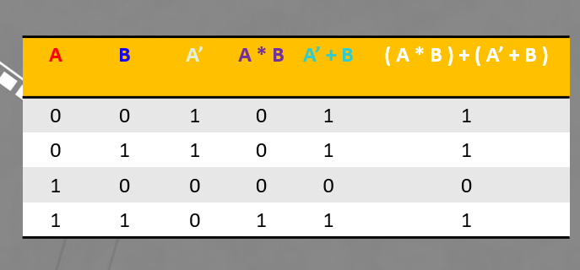
Esencialmente existen tres formas de resolver ejercicios de compuertas lógicas, cada una depende del punto de partida
( A * B ) + ( A’ + B )
NOT
AND
OR
OR

Slide 3
A | B | A’ | A * B | A’ + B | ( A * B ) + ( A’ + B )
0 | 0 | 1 | 0 | 1 | 1
0 | 1 | 1 | 0 | 1 | 1
1 | 0 | 0 | 0 | 0 | 0
1 | 1 | 0 | 1 | 1 | 1
( A * B ) + ( A’ + B )
NOT
AND
OR
OR

Slide 4
( A * B ) + ( A’ + B )
NOT
AND
OR
OR
A | B | A’ | A * B | A’ + B | ( A * B ) + ( A’ + B )
0 | 0 | 1 | 0 | 1 | 1
0 | 1 | 1 | 0 | 1 | 1
1 | 0 | 0 | 0 | 0 | 0
1 | 1 | 0 | 1 | 1 | 1

Slide 5
( A * B ) + ( A’ + B )
NOT
AND
OR
OR
A | B | A’ | A * B | A’ + B | ( A * B ) + ( A’ + B )
0 | 0 | 1 | 0 | 1 | 1
0 | 1 | 1 | 0 | 1 | 1
1 | 0 | 0 | 0 | 0 | 0
1 | 1 | 0 | 1 | 1 | 1

Slide 6
XOR
XNOR
OR
NOR
AND
NAND
NOT

